Slide 1

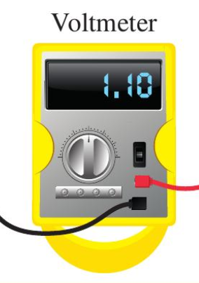








${Na}^{+}$
$$Cl^{−}$$
$$Zn^{2+}$$
$$Cu^{2+}$$
$$NO_{3}^{−}$$
$$NO_{3}^{−}$$
$$Zn(s)$$
$$Cu(s)$$

Slide 2
${Na}^{+}$
$$Cl^{−}$$
$$Zn^{2+}$$
$$Cu^{2+}$$
$$NO_{3}^{−}$$
$$NO_{3}^{−}$$
$$Zn(s)$$
$$Cu(s)$$

Slide 3
${Na}^{+}$
$$Cl^{−}$$
$$Zn^{2+}$$
$$Cu^{2+}$$
$$NO_{3}^{−}$$
$$NO_{3}^{−}$$
$$Zn(s)$$
$$Cu(s)$$

Slide 4
${Na}^{+}$
$$Cl^{−}$$
$$Zn^{2+}$$
$$Cu^{2+}$$
$$NO_{3}^{−}$$
$$NO_{3}^{−}$$
$$Zn(s)$$
$$Cu(s)$$

Slide 5
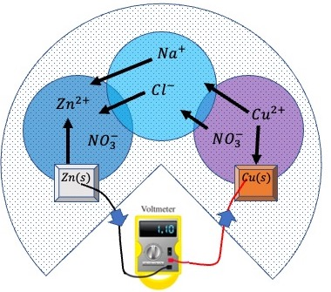
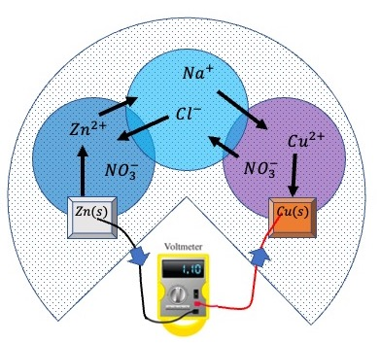
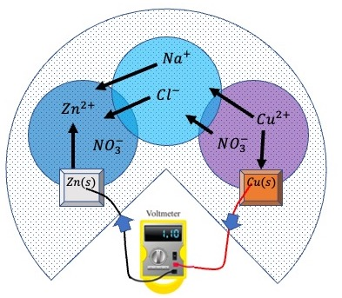
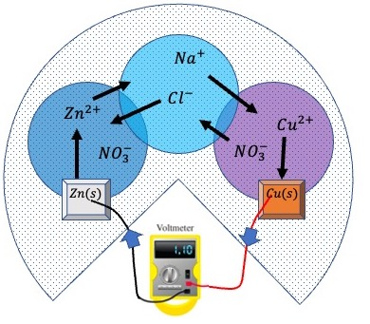
A
B
C
D

